Slide 1
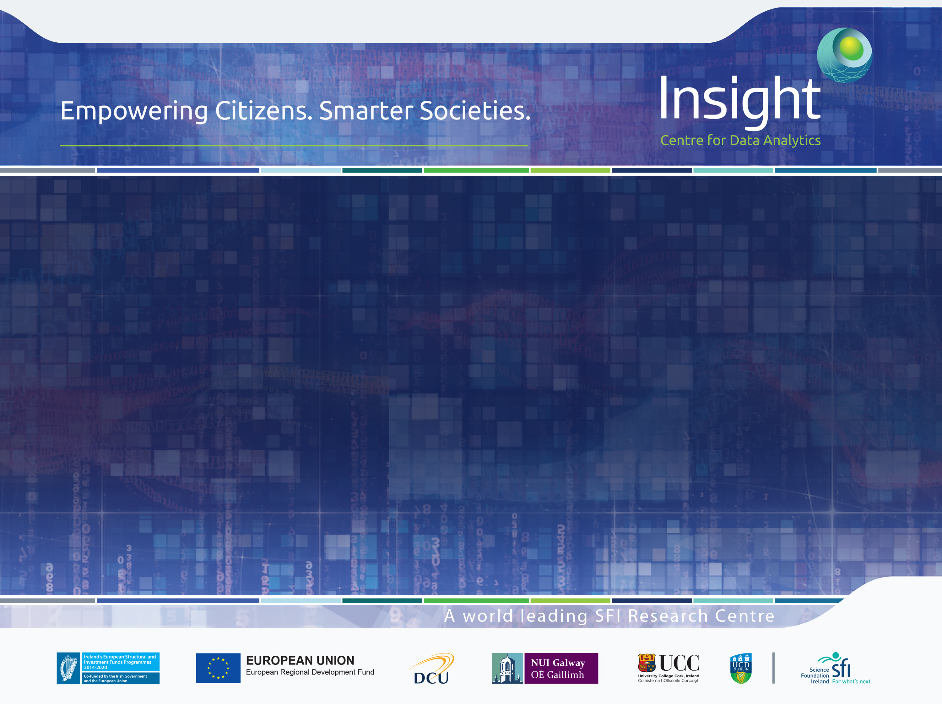
Improving Wordnets for Under-Resourced Languages Using Machine Translation
Bharathi Raja Chakravarthi, Mihael Arčan and John McCrae
National University of Ireland, Galway

Slide 2
Overview
Motivation
Background
Methodology
Results
Conclusion

Slide 3
Motivation

Slide 4
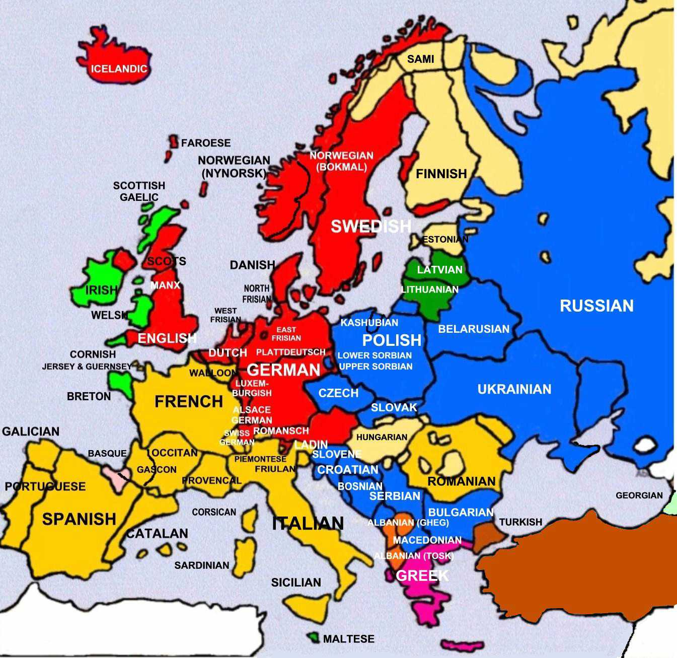
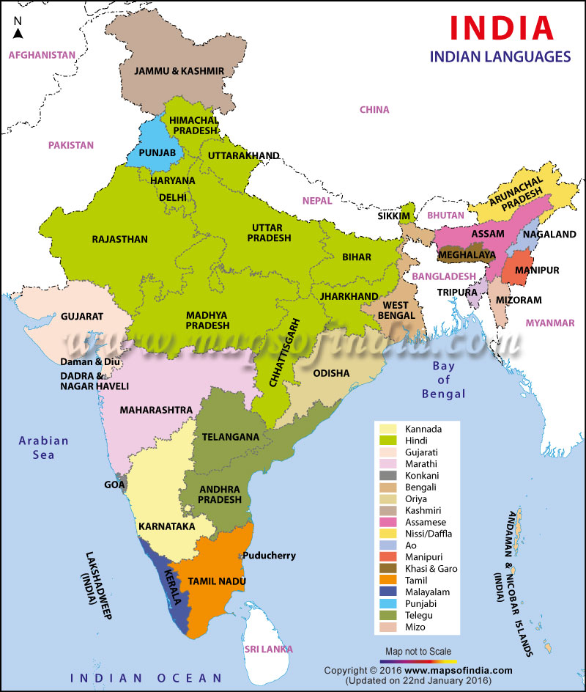
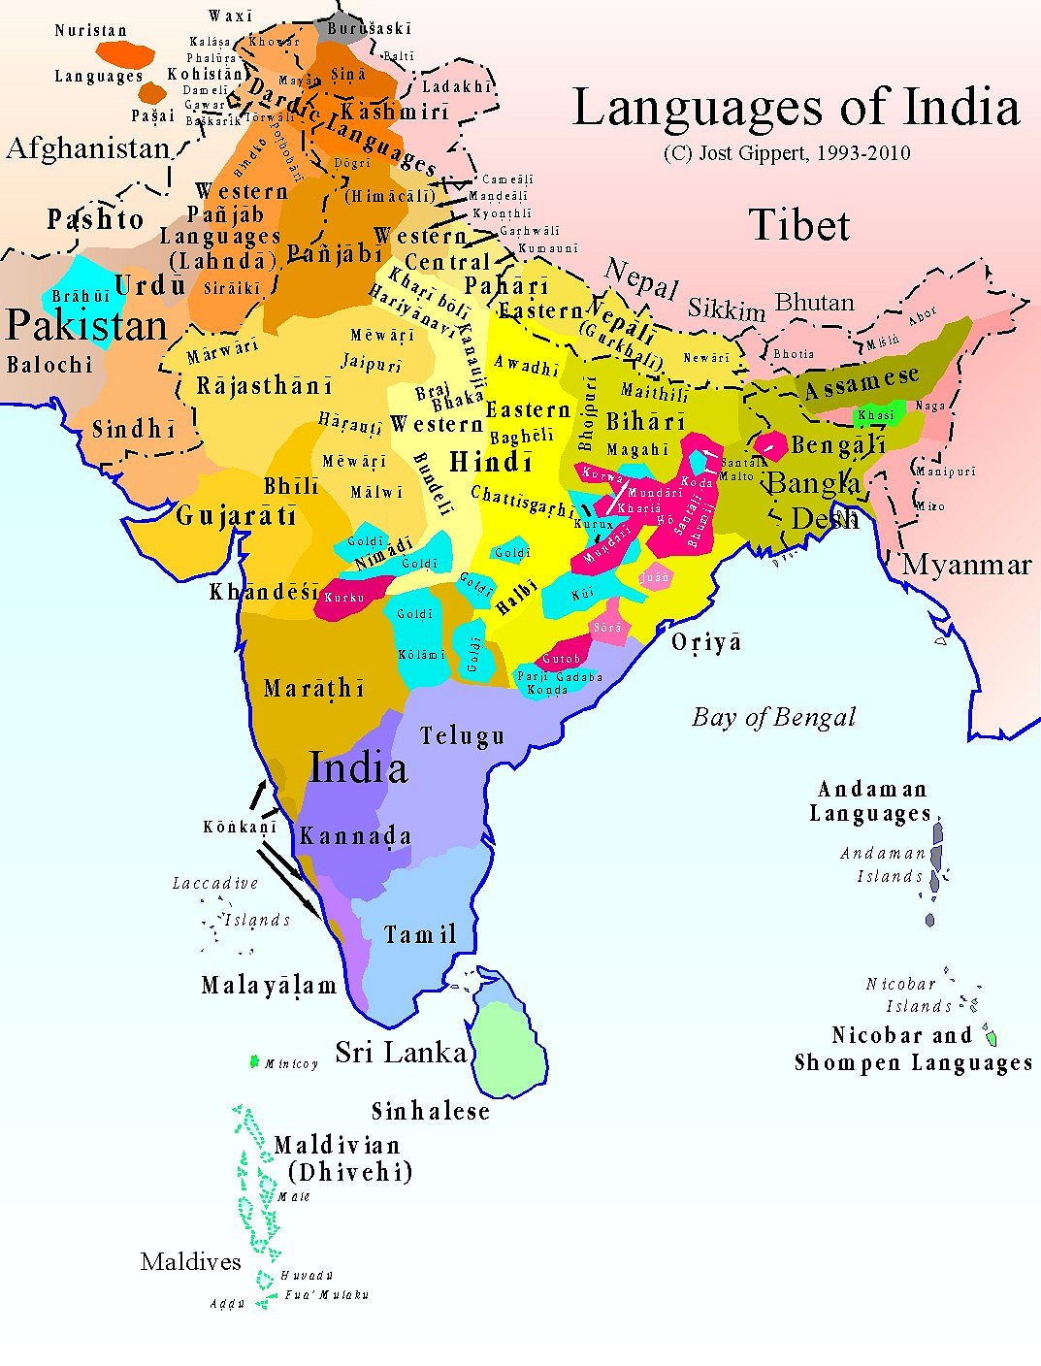
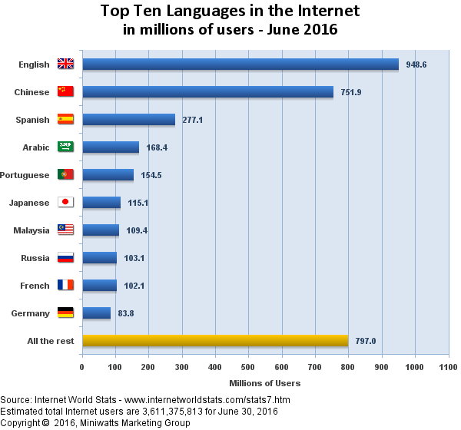
Motivation
Multilingual and global community
Contents in internet are in English followed by few popular languages.
Online services are in the foreign language.
People feel comfortable if the content in their own languages.
http://www.languagesofeurope.co.uk/

Slide 5
Motivation
Applying the work of Arcan et al 2016 for under-resourced languages
Dealing with code-mixing - improvement results
This work aims to help in a semi-automatic lexicon construction process for under-resourced languages

Slide 6
Background

Slide 7
Which languages are “under-resourced” ?
All the world languages
The answer is relative
Six different levels
Third level and fourth level
Languages that have writing system
Languages with any resource in Internet
Languages with any HLT application
Top ten languages
Most resourced language
(English)
Alegria, Iñaki, et al. "Strategies to develop Language Technologies for Less-Resourced Languages based on the case of Basque." :2011.
7
Notes:
email or website, social media
MT solutions will cost less than traditional human translation.
When your requirements do not call for distribution level quality a heavily machinebased solution is faster and significantly less costly.
More and more, companies are faced with the challenge of producing distributionquality translated materials in volumes and within timelines that do not allow for full human translation.

Slide 8
Wordnets
Large lexical database
Nouns, verbs, adjectives and adverbs are grouped into sets of cognitive synonyms (synsets) (Miller, 1995; Fellbaum,2010)
Synsets are interlinked by means of conceptual-semantic and lexical relations. (Miller, 1995; Fellbaum,2010)
Approaches for constructing wordnets (Vossen,1997)
Merge
synsets and relations are built independently
Expand
synsets are built in correspondence with the existing wordnet synsets
Notes:
WordNet is a lexical database for the English language. It groups English words into sets of synonyms called synsets, provides short definitions and usage examples, and records a number of relations among these synonym sets or their members.
Word-sense disambiguation
vessal, bank, board
Document classification
What is this text about? Look for recurring hypernyms
Document retrieval
eg looking for texts about sports cars, search for synonyms and hyponyms of sports car
Open-domain Q/A
Searching texts (eg WWW) to answer questions expressed in natural language
Merge approach
The synsets and relations are built independently and then aligned with WordNet.
The drawbacks of the merge approach are that it is time-consuming and requires a lot of manual effort to build.

Slide 9
WordNet: History
1985: a group of psychologists and linguists start to develop a “lexical database”
Princeton University
EuroWordNet (Vossen,1997)
Dutch, German, French, Spanish, Italian, Czech, Estonian
Expand approach
IndoWordNet (Bhattacharyya, 2010)
Covers major three families: Indo-Aryan, Dravidian and Sino-Tibetan languages.
It was compiled for eighteen out of the twenty-two official languages.
Expand approach
Notes:
It was compiled for eighteen out of the twenty-two official languages and made publicly available

Slide 10
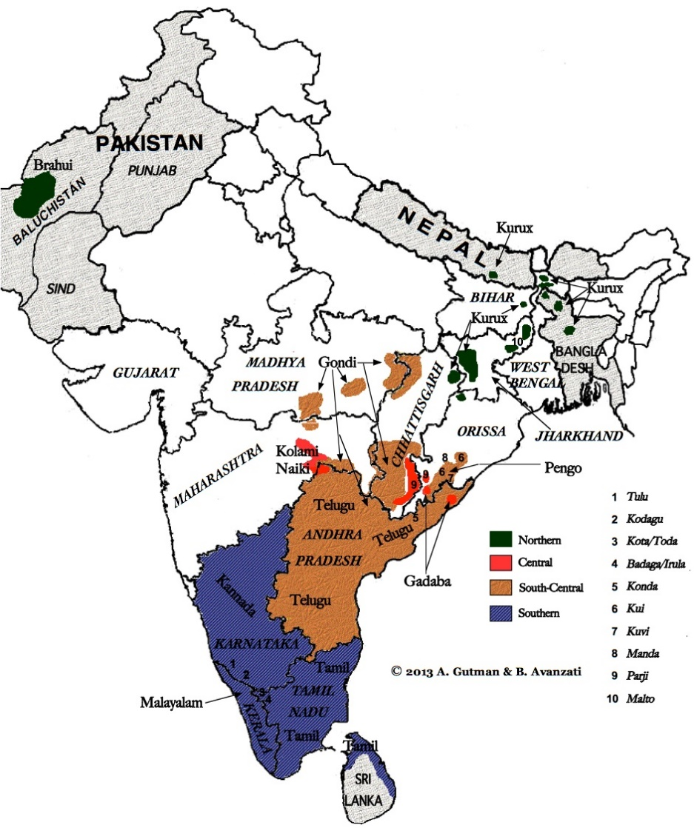
Dravidian Languages
Divided into four groups: (Vikram and Urs, 2007).
South, South-Central, Central, and North groups.
Morphology is agglutinative and exclusively suffixal.
Free word-order languages.
Different scripts
Languages under study: Tamil, Telugu and Kannada

Slide 11
Methodology

Slide 12
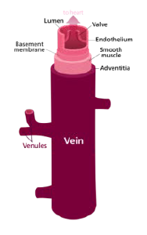
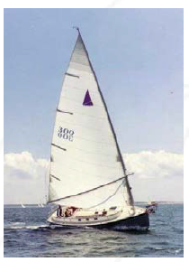
Expanding wordnets to new languages with multilingual sense disambiguation (Arcan et al., 2016)
WordNet Entry vessel:
S: (n) vessel, vas (a tube in which a body fluid circulates)
S: (n) vessel, watercraft (a craft designed for water transportation)
S: (n) vessel (an object used as a container (especially for liquids))

Slide 13
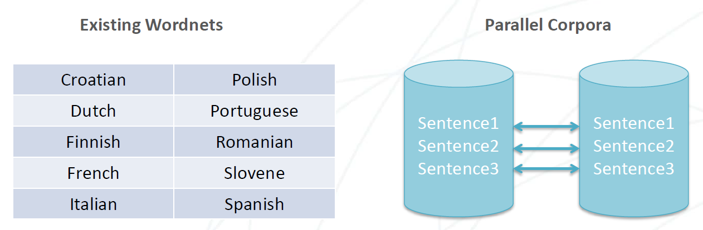
Expanding wordnets to new languages with multilingual sense disambiguation (Arcan et al., 2016)
Select the most relevant sentence from a parallel corpus – based on the overlap with existing translation of WordNet in as many pivot languages a possible
Weed
i105476: any plant that crowds out cultivated plants or
i57595: street names for marijuana

Slide 14


Methodology
context from Arcan et al., 2016a
….. love……….
Love………..
……………. love
I love French food
1 2 3 4
Parallel Corpora
Machine Translation
System
What a storm ! | என்ன ஒரு புயல் !
Anyway , I have what I need . | எப்படியோ எனக்கு என்ன தேவையோ அது இருக்கு .
I don 't want to go there anymore . | எனக்கு அங்கே போகவே பிடிக்கல
One day , a horseman arrived in the city ... | ஒரு நாள் ஒரு குதிரை வீரன் நகரத்திற்கு வந்தான் ...
………………… விரும்பு………………….
……விருப்பம் ...............................
……………………….. நேசிக்கிறேன்…………….
நான் பிரஞ்சு உணவு நேசிக்கிறேன்
1 3 4 2
Giza++
Selecting top 10 words based on alignment
KenLM
Moses
Comparing with IndoWordNet
Opus.lingfil.uu.se
14
Notes:
MOSES SMT

Slide 15
Parallel Corpora
Corpora | Source/Target tokens | Source/Target types | Sentences
English-Tamil | 7000K/6000K | 134K/459K | 449K
English-Telugu | 258K/226K | 18K/28K | 44K
English-Kannada | 68K/71K | 7K/15K | 13K
Tamil Corpora:
Tirukkuṛaḷ (http://www.projectmadurai.org/)
Bible, news corpus(Ramasamy et al., 2012)
Tanzil(Quran), OpenSubtitles, GNOME, KDE, Ubuntu (Jörg Tiedemann, 2012,)
Telugu and Kannada Corpora:
OPUS: OpenSubtitles, GNOME, KDE, Ubuntu (Jörg Tiedemann, 2012,)
OPUS - an open source parallel corpus: http://opus.lingfil.uu.se/
Notes:
Tokens-number of words
Unique words- types

Slide 16
Code-mixing
Baseline
Source sentence: “இப்போது, நான் அதை loving.”
Transliteration: :Ippōtu, nāṉ atai loving.
Target sentence: “Right now, I'm loving it.”
English/Tamil
All words other than the native script of our experiment are taken out on both sides.
The sentences are removed from both sides if no native script words on target side
Corpora | Tokens | Sentences
English-Tamil | 0.5%(45K)/1.1%(72K) | 0.9%(4k)
English-Telugu | 2.8%(7K)/ 4.9%(12K) | 3.1%(1K)
English-Kannada | 3.5%(2K)/ 9.0%(6K) | 3.4%(468)
After Code-mixing removed
Source sentence: “இப்போது, நான் அதை.”
Transliteration: :Ippōtu, nāṉ atai.
Target sentence: “Right now, I'm it.”
English/Tamil
Number of sentence and tokens removed from the corpus
Notes:
All words other than the native script of our experiment are taken out on both sides.
The sentences are removed from both sides if no native script words on target side

Slide 17
Results

Slide 18
Automatic Evaluation of WordNet sense translation
Precision =TP/(TP+FP)
 | Predicted positive | Predicted negative
Positive class | TP | FN
Negative class | FP | TN
Precision @10 If any match out of top 10- TP
Precision @5 If any match out of top 5-TP
:

Slide 19
Automatic Evaluation of WordNet sense translation
Source
Translation with alignment
One day a horseman arrived in the city ... | ஒரு(1-1) நாள்(2-2) ஒரு(3-3) குதிரை(4-4) வீரன்(4-5) நகரத்திற்கு(8-6) வந்தான்(6-7) ...
(horseman)Word position
குதிரை(4-4) வீரன்(4-5)
Top 10
IndoWordNet
Precision@10,@5, @2, @1
Notes:
why?
why manual eval?

Slide 20
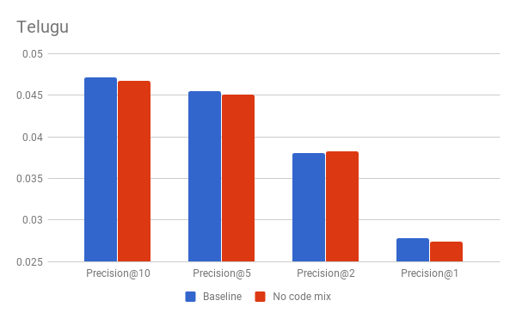
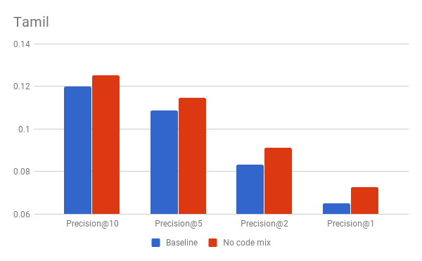
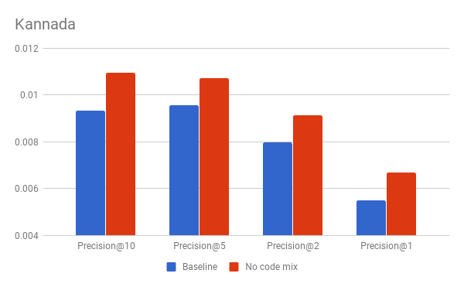
Automatic Evaluation of WordNet sense translation with IndoWordNet

Slide 21
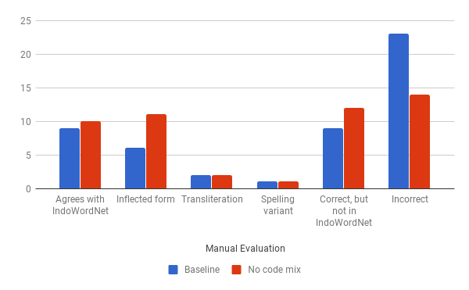
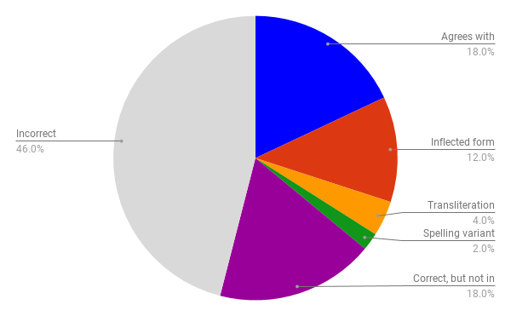
Manual Evaluation of 50 wordnet entries
IndoWordNet

Slide 22
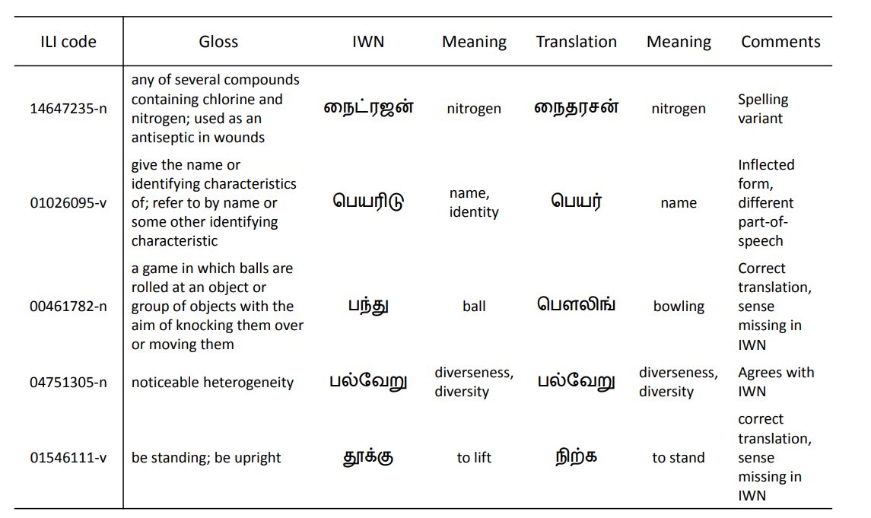
Examples of the manual evaluation of Tamil wordnet entries in comparison to the IndoWordNet

Slide 23
Discussion and Conclusion

Slide 24
Discussion and Conclusion
Automatic results are not so great
a data availability for these language are very little
IndoWordNet is overly skewed to the classical words of these languages
Parallel corpus is in day to day conversation text
Manual evaluation shows that this is far from reality.
Our method can aid the creation or improvement of wordnets for under-resourced languages
Removing of code-mixed text from the corpus results in gains for the wordnet entries with limited data.

Slide 25
Acknowledgements
This work was supported by the Science Foundation Ireland under Grant Number SFI/12/RC/2289 (Insight)
Student support from GWC 2018

Slide 26
Reference
Inaki Alegria, Xabier Artola, Arantza Diaz De Ilarraza, and Kepa Sarasola. 2011. Strategies to develop language technologies for less-resourced languages based on the case of basque.
Mihael Arcan, John P McCrae, and Paul Buitelaar. 2016b. Expanding wordnets to new languages with multilingual sense disambiguation. In Internaional Conference on Computational Linguistics (COLING-2016), Osaka, Japan.
Pushpak Bhattacharyya. 2010. Indowordnet. In Nicoletta Calzolari (Conference Chair), Khalid Choukri, Bente Maegaard, Joseph Mariani, Jan Odijk, Stelios Piperidis, Mike Rosner, and Daniel Tapias, editors, Proceedings of the Seventh International Conference on Language Resources and Evaluation (LREC’10), Valletta, Malta, May. European Language Resources Association (ELRA).
Francis Bond, Piek Vossen, John P. McCrae, and Christiane Fellbaum. 2016. CILI: the Collaborative Interlingual Index. In Proceedings of the Global Word-Net Conference 2016.
Christiane Fellbaum. 2010. Wordnet. In Theory and applications of ontology: computer applications, pages 231–243. Springer.
George A Miller. 1995. Wordnet: a lexical database for english. Communications of the ACM, 38(11):39–41.
Jorg Tiedemann. 2012. Parallel data, tools and interfaces in opus. In Nicoletta Calzolari (Conference Chair), Khalid Choukri, Thierry Declerck, Mehmet U˘gur Do˘gan, Bente Maegaard, Joseph Mariani, Asuncion Moreno, Jan Odijk, and Stelios Piperidis, editors, Proceedings of the Eight International Conference on Language Resources and Evaluation (LREC’12), Istanbul, Turkey, may. European Language Resources Association (ELRA).
T. N. Vikram and Shalini R. Urs, 2007. Development of Prototype Morphological Analyzer for he South Indian Language of Kannada, pages 109–116. Springer Berlin Heidelberg, Berlin, Heidelberg.
Piek Vossen. 1997. Eurowordnet: a multilingual database for information retrieval. In: Proceedings of the DELOS workshop on Cross-language Information Retrieval, pages 5–7.

Slide 27
Improving Wordnets for Under-Resourced Languages Using Machine Translation
Bharathi Raja Chakravarthi
bharathi.raja@insight-centre.org

